Slide 1
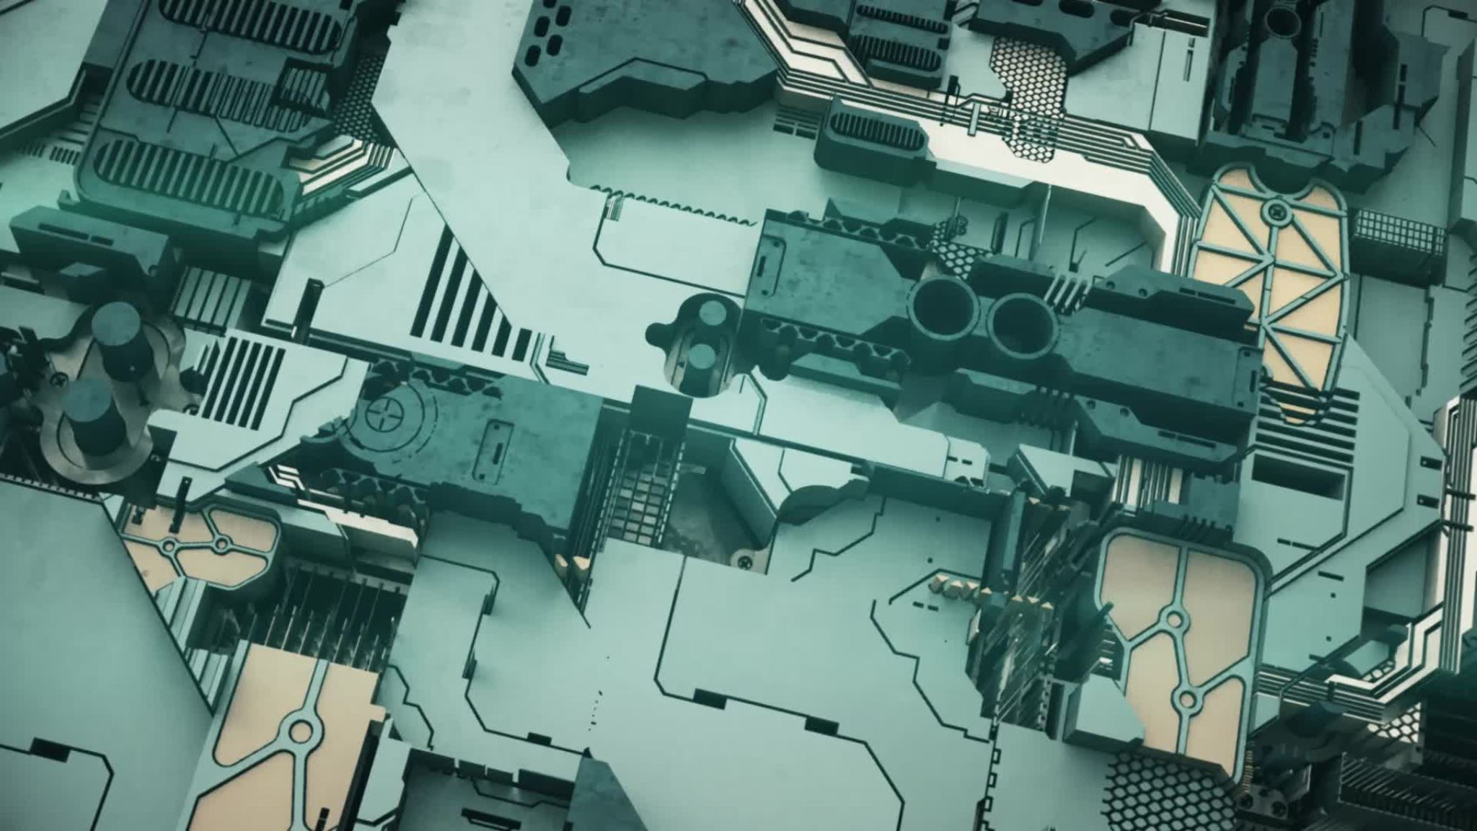
Java Virtual Machine(JVM)
Cindy Chen, Julia Zinda, Cassie Sand, Logan Johansson

Slide 2

Team introduction
History of Java Cindy
Java Class file structure and bytecode Cindy
Java Memory Management Julia
Java implementations – Platforms / vendors Julia
What other languages compile to Java Bytecode Cassie
Android Implementation Cassie
JIT compile/execution Cassie
Performance comparison between C/C++ and Java with and without JIT Logan
Sample Java program with explanation of bytecode Logan

Slide 3

Project introduction
Java Virtual Machine(JVM):
Java Virtual Machine is a virtual machine that enables computers to run java and non-java language programs
Java Virtual Machine is detailed by a specification that describes the JVM requirement implementations, allowing different programmers using the Java Development Kit(JDK) to not worry about any hardware platform issues
Java Virtual Machine is the cornerstone of the java platform. It is the component of hardware and operating system independence in technology programs. It contains instruction sets and manipulation of various memory usage at run time.
Java Virtual Machine is first implemented by Sun Microsystems Inc., hosted by handheld device software that resembled a contemporary Personal Digital Assistant(PDA)
The newest model is hosted by Oracle's implementations on mobile, desktop, and server devices. It can be implemented by compiling its instruction set to that of a silicon CPU. It can also be implemented in microcode or directly into silicon.

Slide 4
Discussion Points Java Virtual Machine
History of Java Cindy
Java Class file structure and bytecode Cindy
Java Memory Management Julia
Java implementations – Platforms / vendors Julia
What other languages compile to Java Bytecode Cassie
Android Implementation Cassie
JIT compile/execution Cassie
Performance comparison between C/C++ and Java with and without JIT Logan
Sample Java program with explanation of bytecode Logan

Slide 5

History of Java

Slide 6

Java: the roots
FGFGFFG
Java was initially designed for interactive television, but it became overly advanced to accommodate the digital cable television industry at the time
Java was born in the early 1990s as Project "Oak", under a small team of engineers working for the Sun Microsystems Corporation. This team was leaded by James Gosling, whom was the "founding father of Java". The other members of the "Green Team" included Mike Sheridan, Patrick Naughton, and other engineers employed at Sun Microsystems Corporation.
The project name "Oak", originally came from an Oak tress outside of James Gosling's office. Oak tree represents images of solidarity, strength, and durability. It's proven that its name did emphasize the project's importance in modern society.
Goslin's goals were to implement a virtual machine and language similar of C-like syntaxes, with however, greater uniformity and simplicity than C/C++. His main motive was to implement object-oriented programming language, allowing programmers with previous C/C++ backgrounds to learn easier.

Slide 7
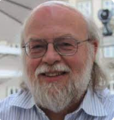
Java: James Gosling
FGFGFFG
James Gosling is born in 05/19/1955, a Canadian computer scientist best known as the founder and lead designer of the Java programming language. Gosling attended the University of Calgary studying computer science and earned his M.A. and Ph.D. from Carnegie Mellon University all in computer science.
Before Gosling joining Sun Microsystems Corporation, he had built multi-processor versions of Unix for a 16-way computer system. He developed several compilers and mail systems while at Carnegie Mellon University.
Gosling was employed with Sun Microsystems Corporation from 1984 - 2010. At Sun Microsystems Corporation, he invented early Unix windowing system and was the father of the Java programming language
Gosling left Sun Microsystems Corporation on April 2nd, 2019, after the Oracle corporation acquisition. Gosling's decision into leaving the company originated in reduction of pay, status, decision-making abilities, changes of roles, and ethical challenges. Gosling has been critical regarding Oracle corporation's interviews, stating that the integration and transition between Sun Microsystems and Oracle Corporation has distributed more problems that was predicted.
After leaving Sun Microsystems Corporation, Gosling joined Google, then followed by his colleague Bill Vass to join a start up called Liquid Robotics. After acquisition by Boeing, Gosling left Liquid Robotics to work at Amazon Web Services as a distinguished engineer in May 2017.
Gosling's contribution to the Java programming language has earned him recognition in many engineering conferences. Gosling has earned many awards and named nominations from 2002- 2019

Slide 8
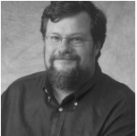
Java: Mike Sheridan
FGFGFFG
Mike graduated from Pitzer College with a degree in Political Science and worked at American University in Film and Video
Mike worked along the "Green Project" members at Sun Microsystems Corporation that conceived and developed the java programming language. While at Sun Microsystems Corporation, Sheridan worked on Java strategy and business development at with Sun Microsystems Corporation's Chief Technology Officer
Mike joined Novell in 1998 as the lead to new product and business opportunity development in the Novell Directory Services(NDS) and Novell's Intelligent Caching System. Mike identifies market opportunities for Novell technologies and invent new products, partnerships, and new lines of business.
Mike has a successful record of working with entrepreneurs and companies dedicated to building values and advancing technology innovations and applications. Mike brings a wealth of high-technology operations experiences and entrepreneurial expertise into companies' technologies.

Slide 9
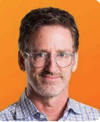
Java: Patrick Naughton
FGFGFFG
Patrick is an American software developer and one of the creators of the Java programming language
While at Sun Microsystems Corporation, Patrick became frustrated with the state of Sun's C++ and C API tools. Patrick worked with James and Mike onto the "Green Project", attempting to develop a new technology for programming next generation smart appliances.
Patrick graduated from Clarkson University
After leaving Sun Microsystems Corporation, Patrick joined Starwave to develop Java server applications for web sites. He then joined Walt Disney for the executive vice president position in 1998.
In 1999, Patrick violated laws and was found guilty of crime arrest. He served five years of probation and nine months of home detention, along with $20,000 fine.
There isn't any more information found in the internet of Patrick since arrest.

Slide 10

Java: the goal
FGFGFFG
According to the developers, Java was developed with several core principles:
Simple,
Robust,
Portable,
Platform-independent,
Secured,
High Performance,
Multithreaded,
Architecture Neutral,
Object-Oriented,
Interpreted,
Dynamic.
While meeting the above core principles, developers also had five primary goals for developing this programming language:
Use the object-oriented programming methodology.
Support executing of the same code on multiple platforms and operating systems.
Built-in computer network support.
Allow secure execution of code from remote sources.
Be easy to learn and use.

Slide 11

Java: development
FGFGFFG
The development of the Java programming language was finished in 1995. Java was intended to be a write-once-run-everywhere capability along with easy accessibility of the software and internet communities to standardize writing applications for complex networks.
Java was based on the "Write once, run anywhere" promise, supporting free runtime son popular platforms.
Java comparing to C/C++, Java offers more security, configurations of security options, and limit access to certain networks and/or files.

Slide 12
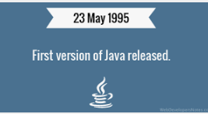
Java: first release
FGFGFFG
Prior to the release in 1995, the project was renamed from "Oak" to "Java", reasoning behind that the original name was already trademark by Oak Technologies. According to James Gosling, the "Green Project" team members had various options for its new programming language name, including Java, DNA, SILK, RUBY, Dynamic, Revolutionary, Jolt, and many others. Gosling decided to name the newly created language Java, while having a cup of coffee near his office. The name Java originates from a sort of espresso bean, part of the production of which comes from the island of Java.
In early 1996, Sun Microsystems Corporation released the first public implementation of Java 1.0. Sun Microsystems Corporation invited developers to download Java 1.0 to start building the next generation of killer applications.​
After the first release, all major web browsers incorporated the ability to run Java applets within web pages, which made Java one of the most mainstreamed technologies in internet programming.
Java has continuously improved since the first release, with new releases yearly, major changes were implemented within the new versions. Java 2 added multiple configurations built for different types of platforms, including APIs for enterprise applications, server environments, mobile applications, and more features modern internet has used.

Slide 13

Java: the new era
FGFGFFG
With the major release of Java 1.0, Java was named one of the "Ten Best Products of 1995" by the TIME Magazine
In November of 2006, Sun Microsystems Corporation released much of its Java Virtual Machine(JVM) as free and open-source software.
The Java language has experienced various augmentations of classes and packages to the standard library. In addition to the language changes, creating more sensational changes to the Java Class Library, Java has developed hundreds to thousands of classes in J2SE 5.
In May 2007, Java completed the process of making Java fully open sourced, by accessing Java Virtual Machine's core code.
In April 2009, Oracle Corporation acquired Sun Microsystems Corporation with its rights to the Java technologies developed within the Green Team. Oracle Corporation offered Sun Microsystems Corporation $5.6 billion in net of Sun's cash and debt.
Following the acquisition, James Gosling(the creator of Java), Tim Bray(the creator of XML), and couple members of the Sun Microsystems Corporation resigned and pursued other corporations
The biggest change in Java technologies under Oracle corporation came in 2017, when Oracle announced that Java will be moved to new versions of release launching every six months, as a way to ensure Java-related technologies are updated in timely manners matching modern-day market advancements.

Slide 14
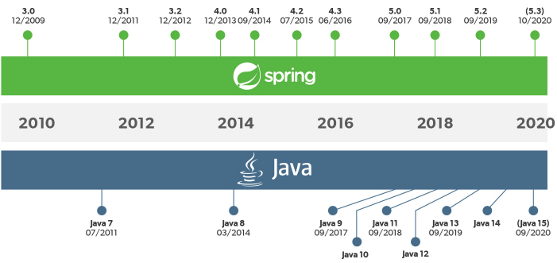
Java: the future
FGFGFFG
Today, Java is well-known as one of the most versatile programming languages in the world. Almost being used everywhere in terms of platforms, many additional features are added to the language. Now, Java is being used in Windows applications, Web applications, enterprise applications, mobile applications, cards, and much more......
Please see the attached link to learn more about new Java versions, releases, release date, and changes of the new release

Slide 15

Java Class File Structure

Slide 16
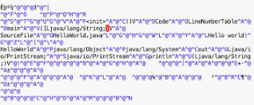
Java Class File
FGFGFFG
Java Class File: a file with the .class filename extension containing Java bytecode that can be executed on the Java Virtual Machine(JVM).
A Java class file is produced by a Java compiler from the Java programming language source file(.java files) containing Java classes. If a source file has more than one class, each class is compiled into a separate class file.
Java Virtual Machine(JVM) is available for many platforms, and a class file compiled from one platform will be executed on a Java Virtual Machine on another platform. Allowing Java applications to be independent from other platforms.
On December 11th of 2006, the Java Specification Request 202 modified class file format successfully.
A class file consists of 8-bit bytes. All 16-bit, 32-bit, and 64-bit are constructed by reading two, four, and eight consecutive 8-bit bytes. Multibyte data items are stored in big-endian order, where the high bytes comes first, and low bytes go last.
The contents of the structures describing the class file format are referred to as items, items are stored in the class file sequentially, without alignment or paddings.
Larger variable-sized items are stored in tables, are used in several class file structures.

Slide 17
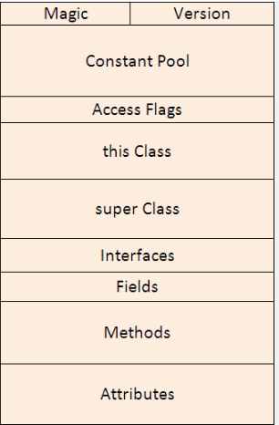
Java Class File Layout and Structure
FGFGFFG
Java Class File Structure contains 10 basic sections :
Magic Number
Version of Class File Format
Constant Pool
Access Flags
This Class
Super Class
Interfaces
Fields
Methods
Attributes

Slide 18
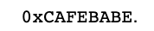
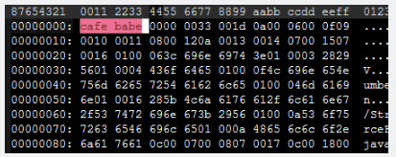
Magic Number
FGFGFFG
Class files are identified by the following 4 byte headers in hexadecimal: CA FE BA BE
The naming convention comes from the creator of Java James Gosling, referring to the restaurant in Palo Alto. Gosling was re-vamping some file format code and needed a couple of magic numbers, one for the persistent object file and one for classes. Gosling used CAFEDEAD for the object file format, for the 4 character hex words that fit after "CAFÉ", then decided to use "BABE". Gosling decided to go with "CADEBABE" for the class file format, and "CAFEDEAD" for the persistent for the object format, which was eventually replaced by "RMI".

Slide 19
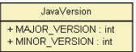
Version of Class File Format
FGFGFFG
The values of the minor_version and major_version items are the minor and major version numbers of this class file. Together, a major and a minor version number determines the version of the class file format.
A class file has a major version number M and minor version number m, we denote the version of its class file format as M.m. So the class file format versions may be ordered from lowest to largest, such as 1.5 < 2.0 < 2.6

Slide 20
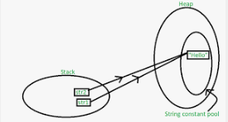
Constant Pool
FGFGFFG
Constant Pool: table of structures representing various string constants, class, interface names, field names, strings, identifier names, references to classes and methods, type descriptors, and other constants that are referred to within the ClassFile structure and its substructures.
The format of each Constant_pool table entry is indicated by its first "tag" byte. The Constant_pool table is indexed from 1 to Constant_pool_count – 1 .

Slide 21
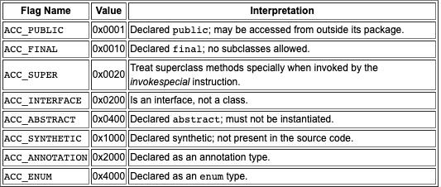
Access Flags
FGFGFFG
Access Flags: the value of the access_flags item is a mask of flags used to denote access permissions to and properties of this class or interface.

Slide 22
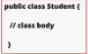
This Class
FGFGFFG
The value of the this_class item must be a valid index into the constant_pool table. The constant_pool entry at that index must be a constant_class_info structure, representing the class or interface defined by this class file
This class refers to the name of the current class

Slide 23
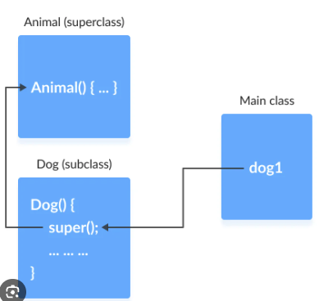
Super Class
FGFGFFG
The value of the super_class item either must be a zero or a valid index into the constant_pool table. If the value of the super_class item is nonzero, then the constant_pool entry at that index must a constant_class_info structure that represents the direct superclass of the class defined by this class file.
If the value of the super_class is zero, then the this class file will represent the class object, the only class or interface without a direct superclass.
For the interface, the value of the super_class item must always be a valid index into the constant_pool table. The entry at that index must be a constant_class_info structure representing the class object

Slide 24
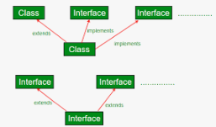
Interface
FGFGFFG
Each value in the interface array must be a valid index into th econstant_pool tbale. The entry at each value of interfaces[I], where 0< I < interfaces_count, must be a constant_class_info structure representing an interface that is the direct superinterface of another class or interface.
The value of the interface_count refers to the number of direct superinterfaces of this class or interface type.

Slide 25
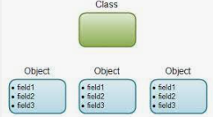
Fields
FGFGFFG
Each value in the fields table must be a field_info structure giving a complete description of a field in this class or interface.
The field table includes only those fields that are declared by the class or interface, it doesn't include items that represents fields that are inherited from superclasses or superinterfaces.
The fields_count refers to the number of field_info structure in the fields table, representing all fields, class variables, and instance variables declared by this class or interface type.

Slide 26
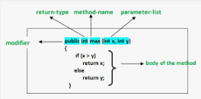
Methods
FGFGFFG
Each value in the methods table must be a method_info structure givng a complete description of a method in this class or interface.
The method_info structures represent all methods declared by its class or interface type, including instance methods, class methods, instance initialization methods, and all class or interface initialization methods. It doesn't include any items representing methods that are inherited from superclasses or superinterfaces.
The methods_count value refers to the number of method_info structures in the methods table

Slide 27
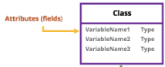
Attributes
FGFGFFG
Each value of the attributes table must be an attribute_info structure.
The Java Virtual Machine implementation is required to ignore any or all attributes in the attributes table of a ClassFile structure that doesn't recognize it. Attributes not defined in the specification are not allowed to affect the semantics of the class file, but only allowed to add additional descriptive information

Slide 28
Resources
https://en.wikipedia.org/wiki/Java_virtual_machine
https://en.wikipedia.org/wiki/James_Gosling
https://www.bluechairgroup.com/team/mike-sheridan/
https://en.wikipedia.org/wiki/Patrick_Naughton
https://en.wikipedia.org/wiki/Acquisition_of_Sun_Microsystems_by_Oracle_Corporation
https://www.javatpoint.com/history-of-java
https://codegym.cc/groups/posts/594-history-of-java-a-full-story-of-java-development-from-1991-to-2021
https://www.geeksforgeeks.org/the-complete-history-of-java-programming-language/
https://docs.oracle.com/javase/specs/jvms/se7/html/jvms-4.html
https://en.wikipedia.org/wiki/Java_class_file

Slide 29
Project Summary:
History of Java
Java: the roots
James Gosling
Mike Sheridan
Patrick Naughton
Java: the goal
Java: development
Java: first release
Java: the new era
Java: the future
Java Class File Structure
Java Class File
Java Class File Layout and Structure
Magic Number
Version of Class File Format
Constant Pool
Access Flags
This Class
Super Class
Interface
Fields
Methods
Attributes

Slide 30
FGFGFFG

